Slide 1


Control Engineering Experiment: Arduino Tube

Slide 2
PID controller
Machines and processes that need constant management and automated modification are frequently managed with a feedback-based control loop mechanism called a proportional-integral-derivative (PID) controller.
The present set point (SP) − process variable (PV) error value is proportional to term P.
Term I generates the I term by integrating the past values of the SP − PV error over time.
Term D is the best estimate of the SP − PV error’s future trend.

Slide 3
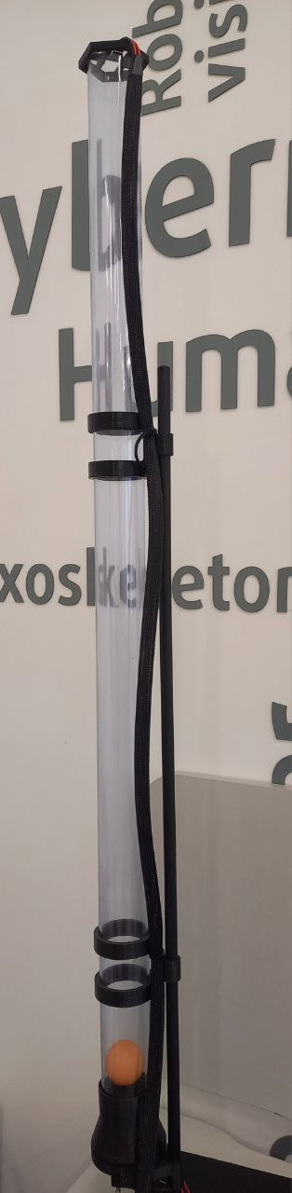
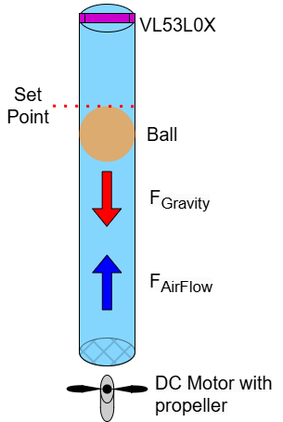
Hardware
In this experiment the motor with propeller is used to create air flow that will overcome the gravitation and rise the ball up into the air to the set point level inside an aerodynamic tune. On the picture bellow is showed hardware scheme of the experiment.

Slide 4
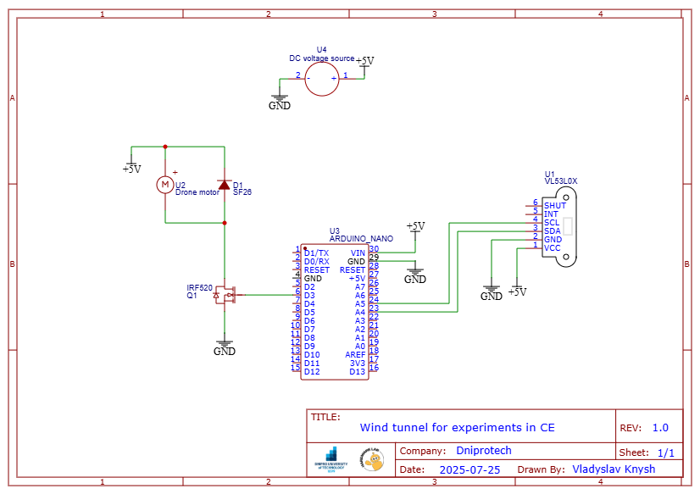
Hardware

Slide 5
Assignment
In this experiment students are tasked with controlling the aforementioned tube system. The experiment is separated into 4 parts:
Direct control
P + direct control
PD + direct control
PID + direct control

Slide 6
Step 1: Direct control of the motor
Objective: To find the coefficient of direct control.
1)Prepare the sketch:
Write the primary sketch that will help you use PWM of the Arduino`s D3 pin to control the motor speed.
2)Find the coefficient:
There are two main possible roots of performing this task:
a) You can start from 0 and gradually increase the PWM value until the ball almost rises up into the air;
b) Or you can start from the 255 and gradually decrease the PWM value until the ball almost rises up into the air;
3) Write down the result:
Write down the coefficient that was found. It will be used in the next tests.

Slide 7
Step 2: Proportional controller
Objective: To program the algorithm of the Proportional controller. and to find the KP value with low steady state error.
1)Modify Your Code:
Add the following lines to enable laser-ranging module VL53L0X:
#include <Wire.h>
#include <VL53L0X.h>
VL53L0X sensor;
//Enter your global variables here
// the setup function runs once when you press reset or power the board
void setup() {
Serial.begin(9600);
Wire.begin();
sensor.setTimeout(500);
if (!sensor.init()) {
Serial.println("Failed to detect and initialize sensor!");
while (1) {}
}

Slide 8
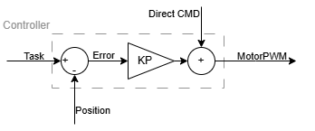
Step 2: Proportional controller
2)Make motorCMD dynamic:
Use while loop to perform experiment. The experiment should be around 15-30 seconds long.
motorCMD should change proportionally to the errorValue.
Due to the position of the VL53L0X errorValue can be calculated as follows: 975 - errorValue .
Experiment with the KP value to achieve lower steady state error.

Slide 9
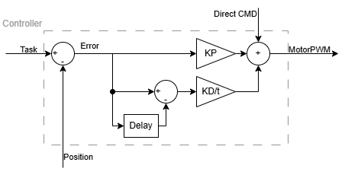
Step 3: Proportional-derivative controller
Objective: To add derivative control to stabilize the system.
1)Understand the derivative controller:
Based on the SetPoint − realPosition error’s current rate of change, derivative controller represents the best prediction of its future trend.
i.e. the relation between Change In Error and Change In Time
(Errori​−Errori−1​)/(dt∗i)
2)Implement the derivative control:
Modify the existing loop to use the PD controller.
To make the loops more consistent, you should implement a second timer so that each iteration takes the same time.
Try to find the best combination of kp and kd coefficients for a fast rise time with not too much overshoot and low steady state error.

Slide 10
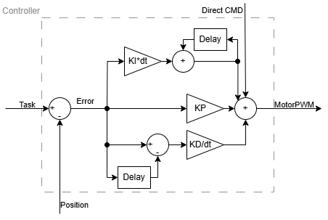
Step 4: Proportional-derivative controller
Objective: To reduce the steady state error by adding the integral control.
1)Understand the integral controller:
Integral term sums up all past errors.
You can calculate KI as follows KIi​=KIi−1​+dt∗ki∗Errori, where ki is the chosen coefficient of the integral controller
2)Implement the derivative control:
Implement the PID + direct controller.
Try to find the best combination of kp, ki and kd coefficients for the best performance.

Slide 11


Additional materials
All additional materials related to the experiments and equipment can be found on the project page on GitHub.
GitHub:
https://github.com/VladyslavKnysh/edrys-labs_ArduinoTube

